Slide 1
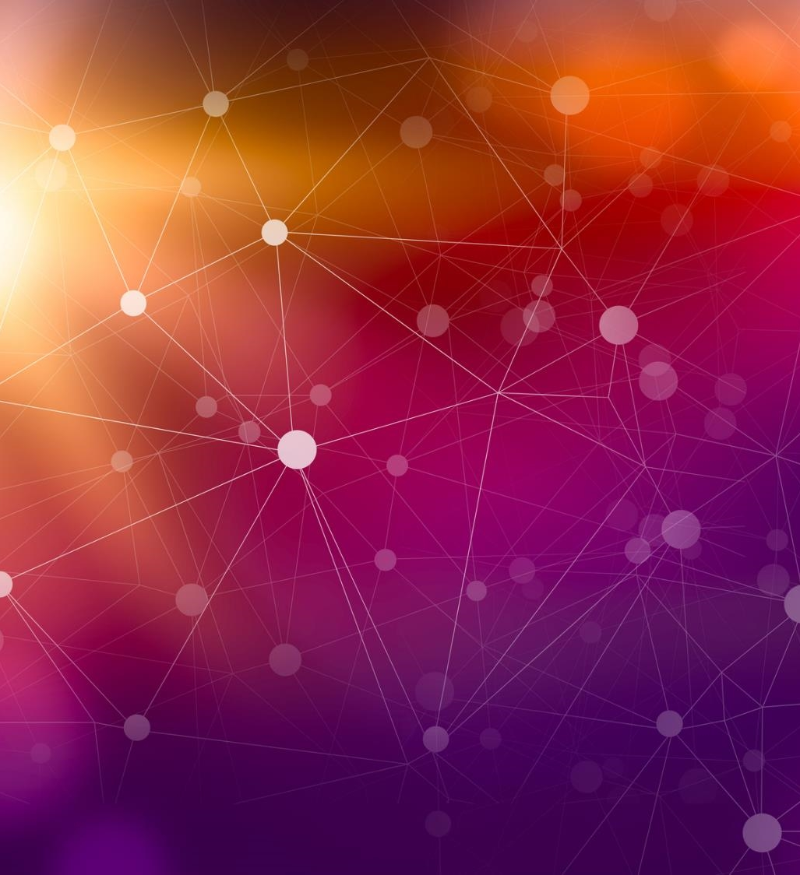
Quantum Transfer Learning

Slide 2
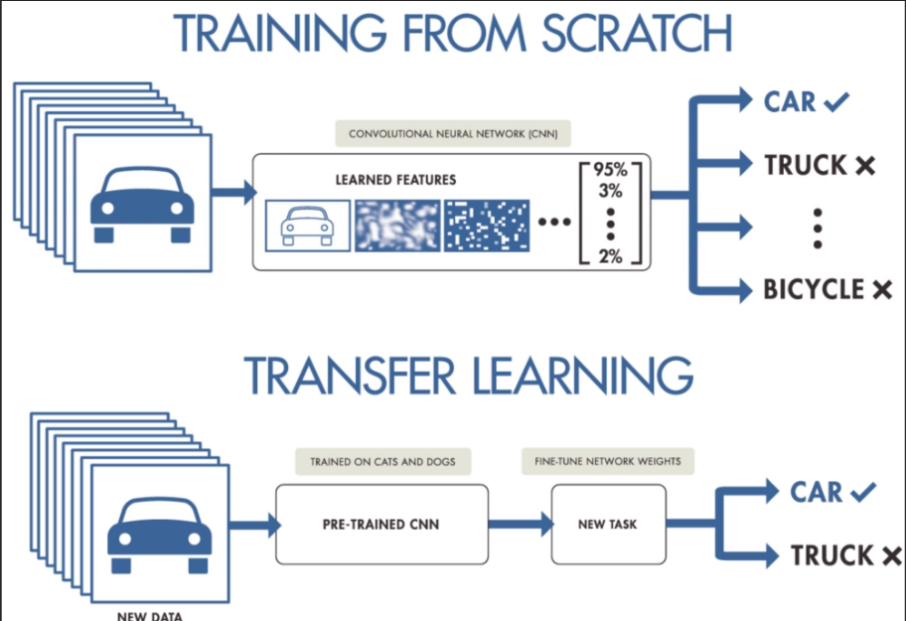
What is Transfer Learning ?
Transfer learning is a well-established technique for training artificial neural networks which is based on the general intuition that if a pre-trained network is good at solving a given problem, then, with just a bit of additional training, it can be used to also solve a different but related problem.

Slide 3
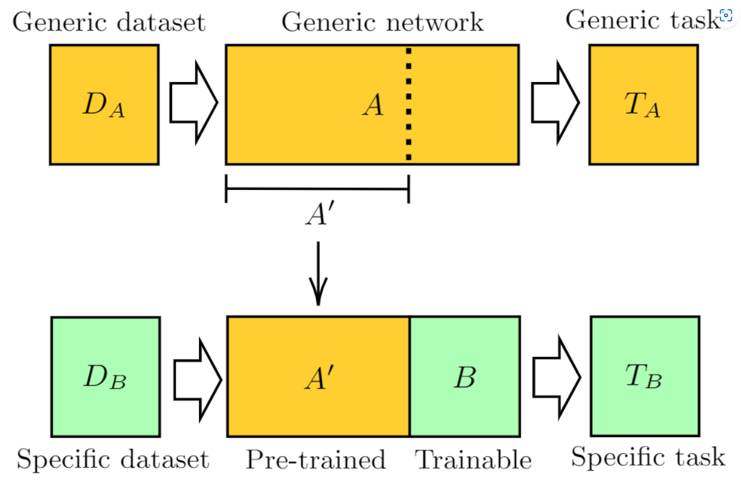
As pre-trained network A we use ResNet18, a deep residual neural network introduced by Microsoft which is pre-trained on the ImageNet dataset.
After removing its final layer we obtain A′, a pre-processing block which maps any input high-resolution image into 512 abstract features.

Slide 4

CNN(Convolutional Neural Network) for Image Classification :

Slide 5
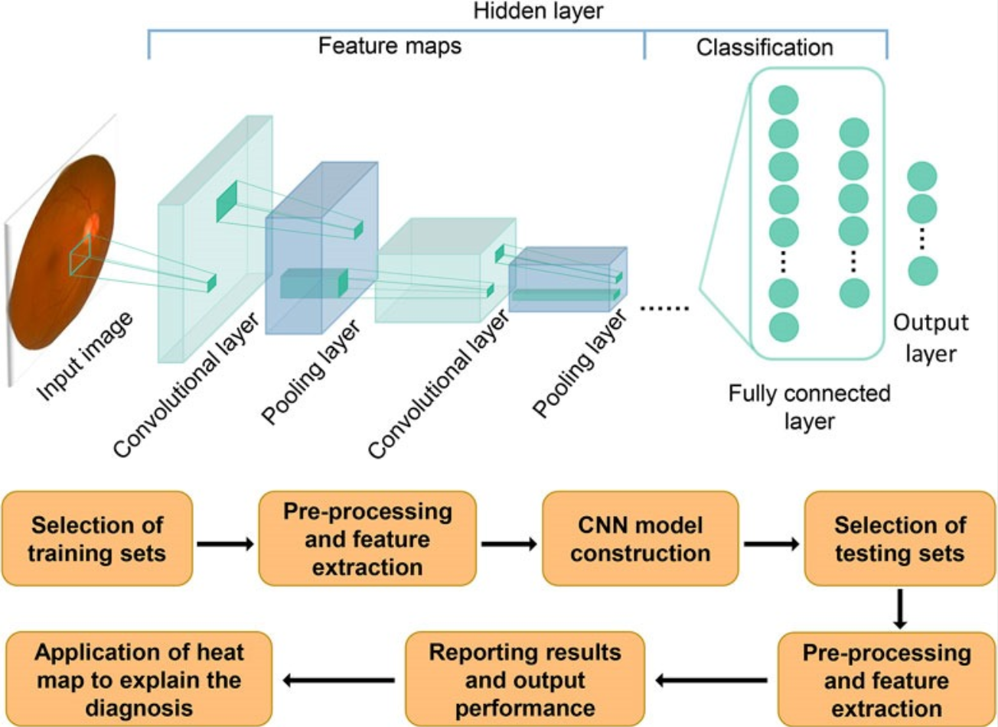

Slide 6

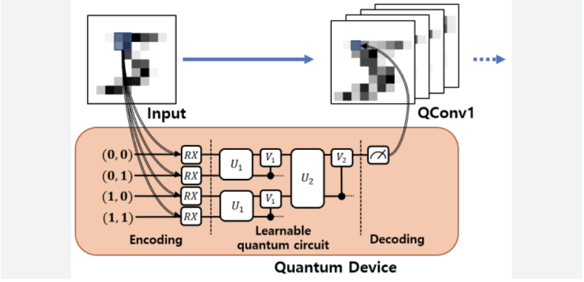
Classical-to-Quantum Transfer Learning

Slide 7
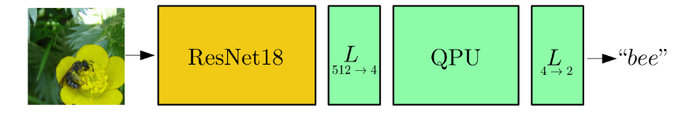
We focus on the CQ transfer learning scheme discussed in the previous section and we give a specific example.
Image abstract features are classified by a 4-qubit “dressed quantum circuit” B, i.e., a variational quantum circuit sandwiched between two classical layers.
The hybrid model is trained, keeping ResNet18 weights constant, on the Hymenoptera dataset (a small subclass of ImageNet) containing images of ants and bees.

Slide 8
Implementation using Python :

Slide 9
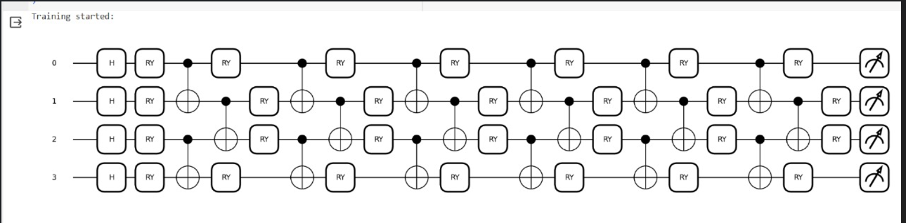
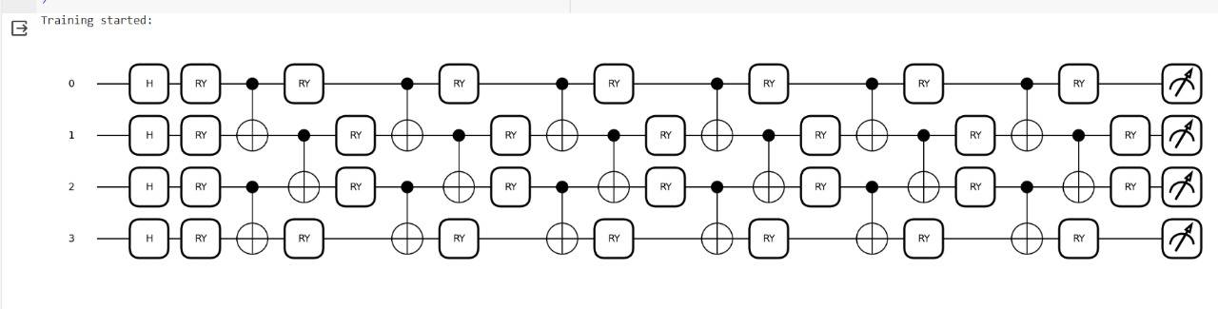

Slide 10
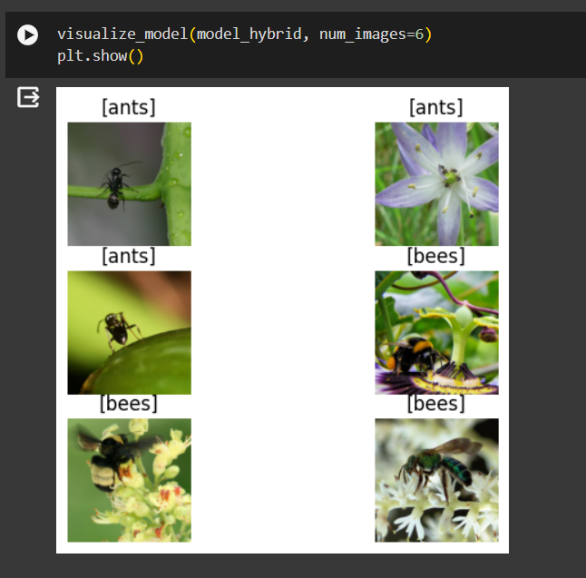
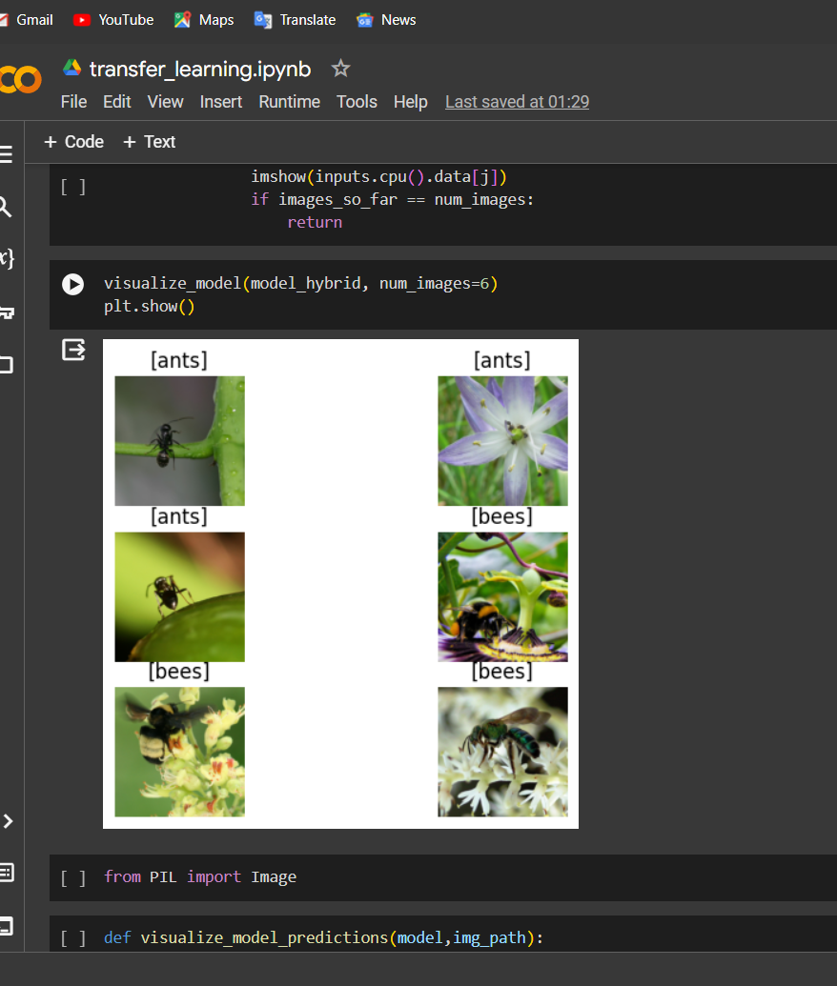
Predictions by the model :

Slide 11
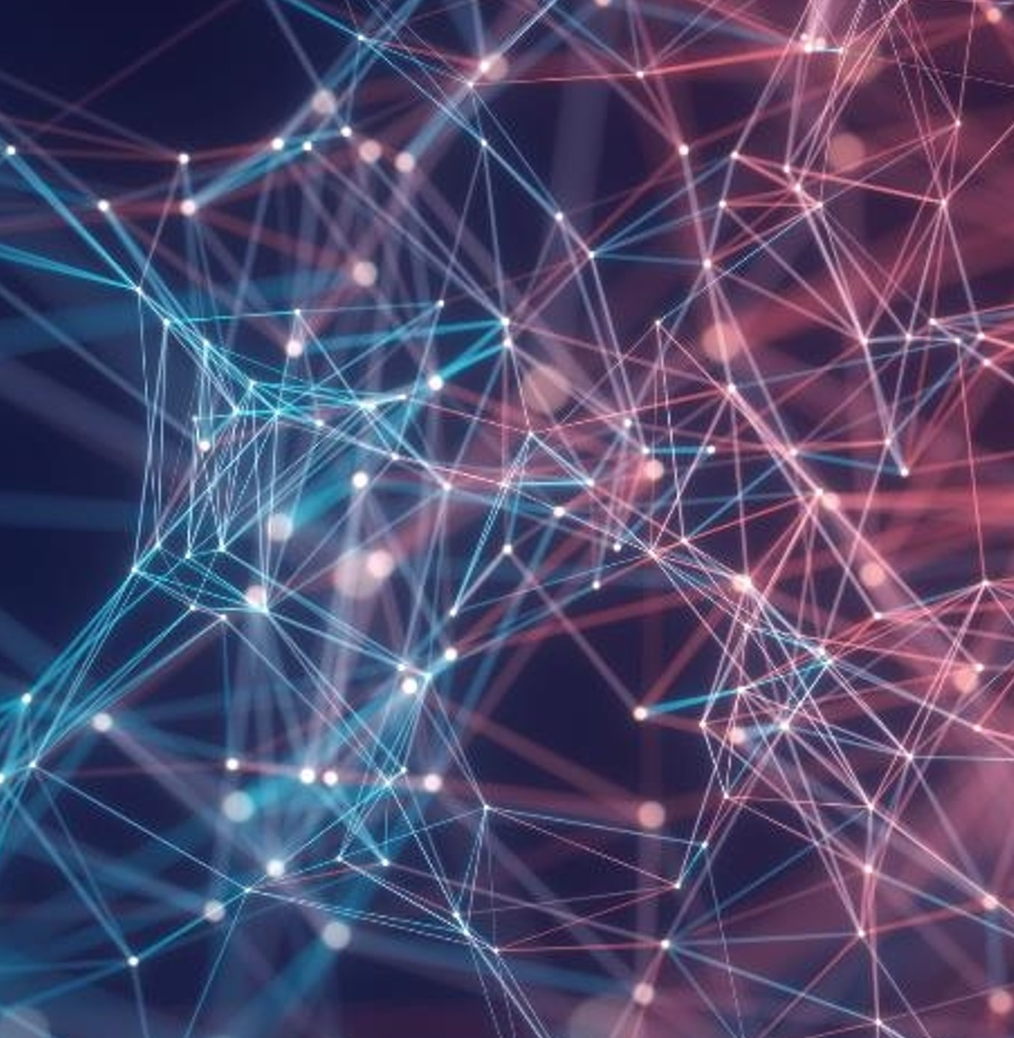
Thank you
Satwik Chaubey
Jagrit
Sajal Jain

